Slide 1
Climate Update
7/17/2020
Still need to explore possibilities NEXRAD (doppler radar data)
DRI website does not provide observational data, only provides 30 year climate normals

Slide 2
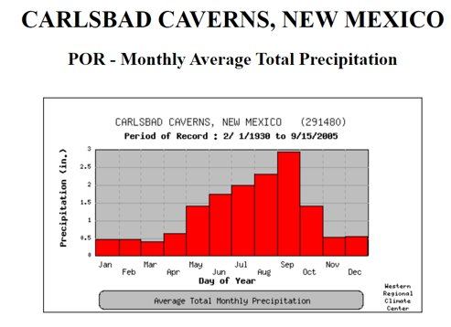
Carlsbad National Park Climate Semi-arid climate with mild winters and hot summers
Annual Precip | Annual Max Temp | Annual Min Temp | Annual Mean Temp | Monsoon Season
37.8 cm | 79°F | 47°F | 63°F | July through September
Weather Records from January 1935 to April 2004​
​ | Record HighTemperature (°F/ºC)​ | Record LowTemperature (°F/ºC)​ | Record HighPrecipitation (in/cm)​ | Average MonthlyPrecipitation (in/cm)​
January​ | 81/27​ | -4/-20​ | 2.37/6.02​ | 0.45/1.14​
February​ | 84/29​ | 1/-17​ | 2.44/6.20​ | 0.43/1.09​
March​ | 94/34​ | 10/-12​ | 3.59/9.12​ | 0.41/1.04​
April​ | 96/36​ | 21/-6​ | 5.81/14.76​ | 0.60/1.52​
May​ | 106/41​ | 31/-1​ | 10.57/26.85​ | 1.42/3.61​
June​ | 110/43​ | 41/5​ | 8.52/21.64​ | 1.71/4.34​
July​ | 106/41​ | 50/10​ | 5.96/15.14​ | 2.06/5.23​
August​ | 104/40​ | 52/11​ | 11.71/29.74​ | 2.38/6.05​
September​ | 100/38​ | 33/1​ | 12.37/31.42​ | 2.90/7.37​
October​ | 97/36​ | 15/-9​ | 5.12/13.00​ | 1.40/3.56​
November​ | 86/30​ | 8/-13​ | 4.50/11.43​ | 0.56/1.42​
December​ | 80/27​ | 2/-17​ | 3.56/9.04​ | 0.48/1.22​
https://www.nps.gov/cave/learn/nature/weather.htm
https://wrcc.dri.edu/cgi-bin/cliMAIN.pl?nmccav

Slide 3
Precipitation Frequency Estimates
https://hdsc.nws.noaa.gov/hdsc/pfds/pfds_map_cont.html?bkmrk=nm​
Interactive map provides point precipitation frequency estimate tables EVERYWHERE in NM with 90% confidence intervals​
Graphical or tabular ​
Ie https://hdsc.nws.noaa.gov/hdsc/pfds/pfds_printpage.html?lat=32.1187&lon=-104.6498&data=depth&units=english&series=pds#maps

Slide 4
Carlsbad Station
Two stations provide hourly, Carlsbad (1947-2014) and Cavern City Airport (1949-2014)
Provides hourly, and Carlsbad provides 15 min
https://www.ncdc.noaa.gov/cdo-web/datasets/PRECIP_HLY/stations/COOP:291475/detail

Slide 5
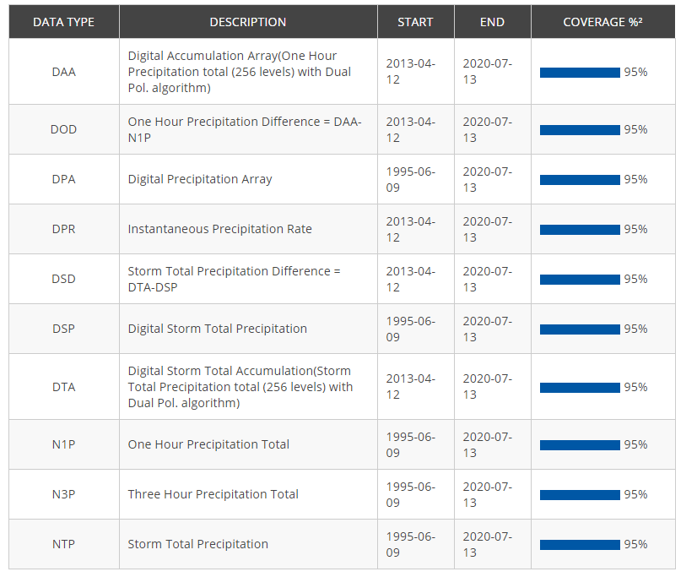
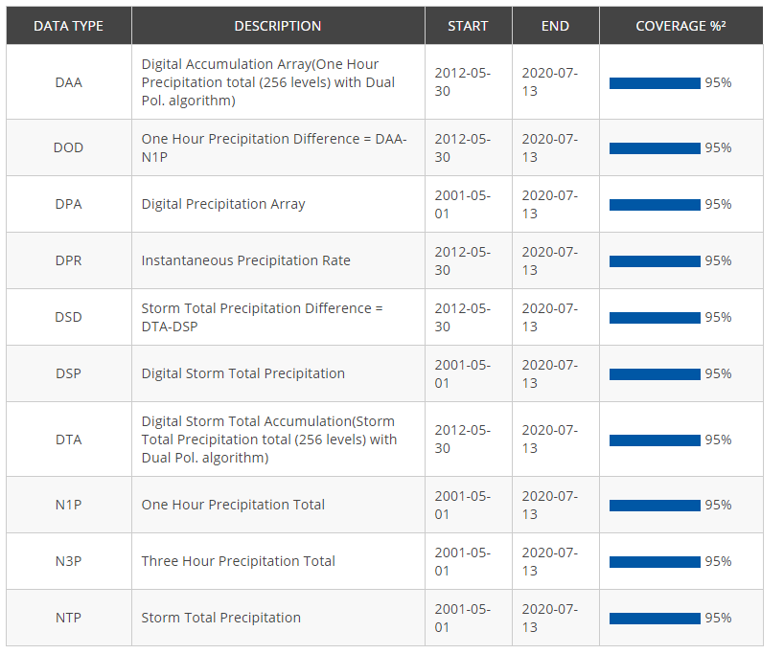
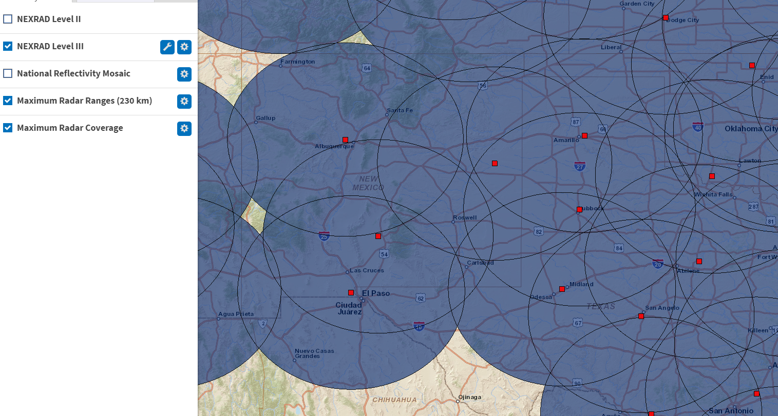
Nexrad Doppler weather radars
2 stations within range
Holloman AFB
https://www.ncdc.noaa.gov/cdo-web/datasets/NEXRAD3/stations/NEXRAD:KHDX/detail
Midland Odessa
https://www.ncdc.noaa.gov/cdo-web/datasets/NEXRAD3/stations/NEXRAD:KMAF/detail

Slide 6
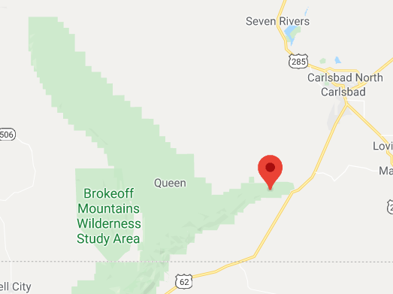
COOP Carlsbad Caverns Station 291480 https://wrcc.dri.edu/cgi-bin/cliMAIN.pl?nmccav
2/1/1930 – 7/17/2020
max/min/avg temp and precip at daily resolution
To access data: http://climate.ncsu.edu/cronos/?station=291480
DRI website doesn’t provide actual data, only gives climate normal based on data
Downloaded, title raw carslabd caverns stn climate data

Slide 7
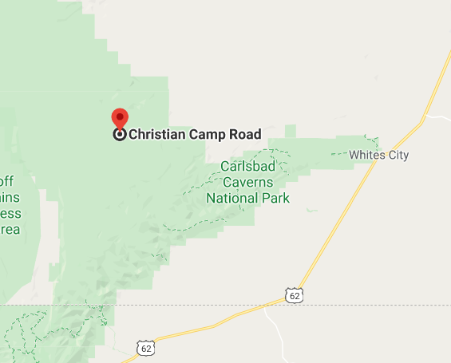
COOP Queen RANGER STATIOn 297176 https://wrcc.dri.edu/cgi-bin/cliMAIN.pl?nm7176
***wrcc.dri.edu… does not provide actual daily data, they only compute averages and 30-year climate summaries, hence why 1981-2010 tab is completely null, no data (same for other stations)
1/1/1963 – 3/31/1975 (contains 4044/4473 days)
daily precipitation (no temp)
To access daily data: http://climate.ncsu.edu/cronos/?station=297176
To access climate summaries: https://wrcc.dri.edu/cgi-bin/cliMAIN.pl?nm7176

Slide 8
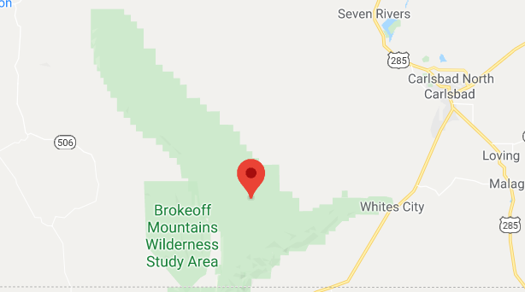
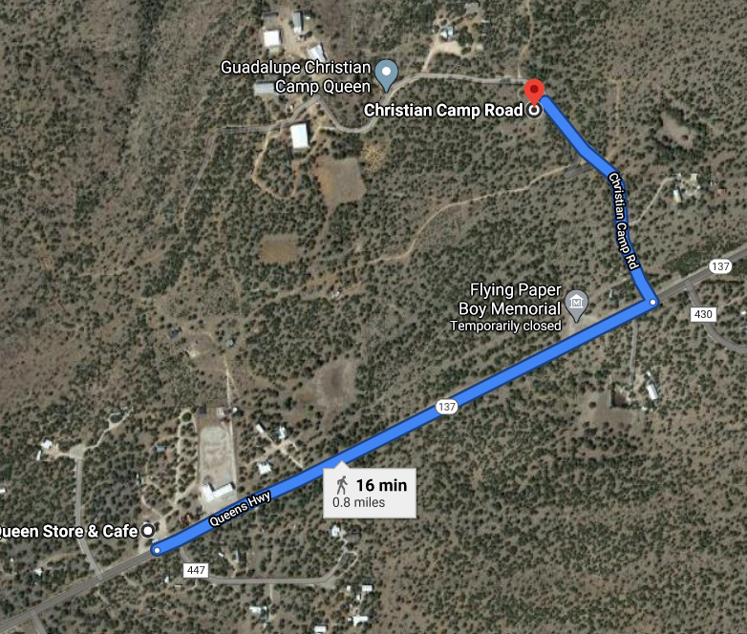
COOP Queen Station 297172 (no DRI climate summaries Exist For this station)
4/28/2000 – 3/7/2007
***2006 and 2007 are empty
Additional Queen station covering later period, .8 miles from Queen RS
max/min/avg temp and precip at daily resolution
Can download in standard or metric
To access data: http://climate.ncsu.edu/cronos/?station=297172
DRI website doesn’t provide actual data, only gives climate normal based on data
Downloaded, title raw carslabd caverns stn climate data

Slide 9
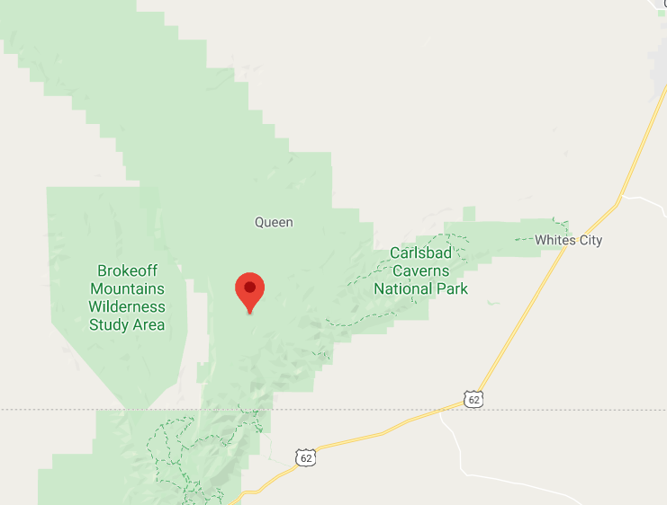
Coop Carson Seep Near 291532 https://wrcc.dri.edu/cgi-bin/cliMAIN.pl?nm1532
2/1/1930 - 5/22/2020
Need to request data from http://climate.ncsu.edu/requestdata
Precip & min/max temp at daily resolution
Can download in standard or metric
To access data: http://climate.ncsu.edu/cronos/?station=291532

Slide 10
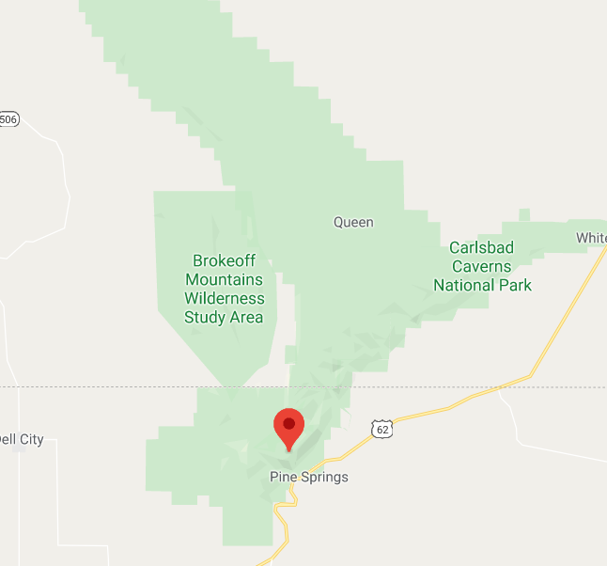
Additional Options https://wrcc.dri.edu/cgi-bin/cliMAIN.pl?nm1532
Three different stations grouped on southern end of range in Texas
TPIN - Pinery http://climate.ncsu.edu/cronos/?station=TPIN
2001-2020
Provides hourly data!
Also wind speed, air temp, dew point, solar radiation, relative humidity
TGUA – The Bowl http://climate.ncsu.edu/cronos/?station=TGUA
1997-2020
Provides hourly!
Also wind speed, sea level pressure, relative humidity, temp, solar radiation
Pine Springs http://climate.ncsu.edu/cronos/?station=417044
1939-2011
Daily precip and temp

Slide 11
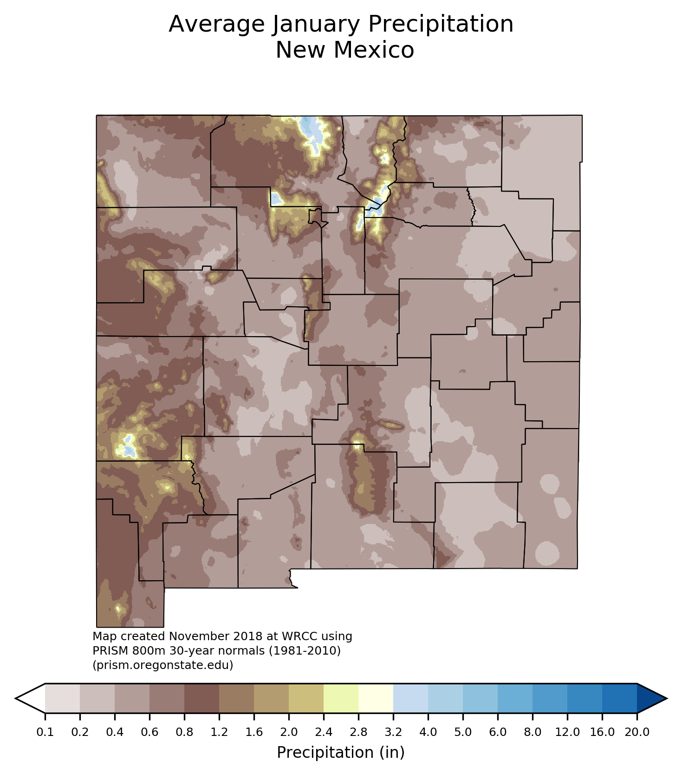
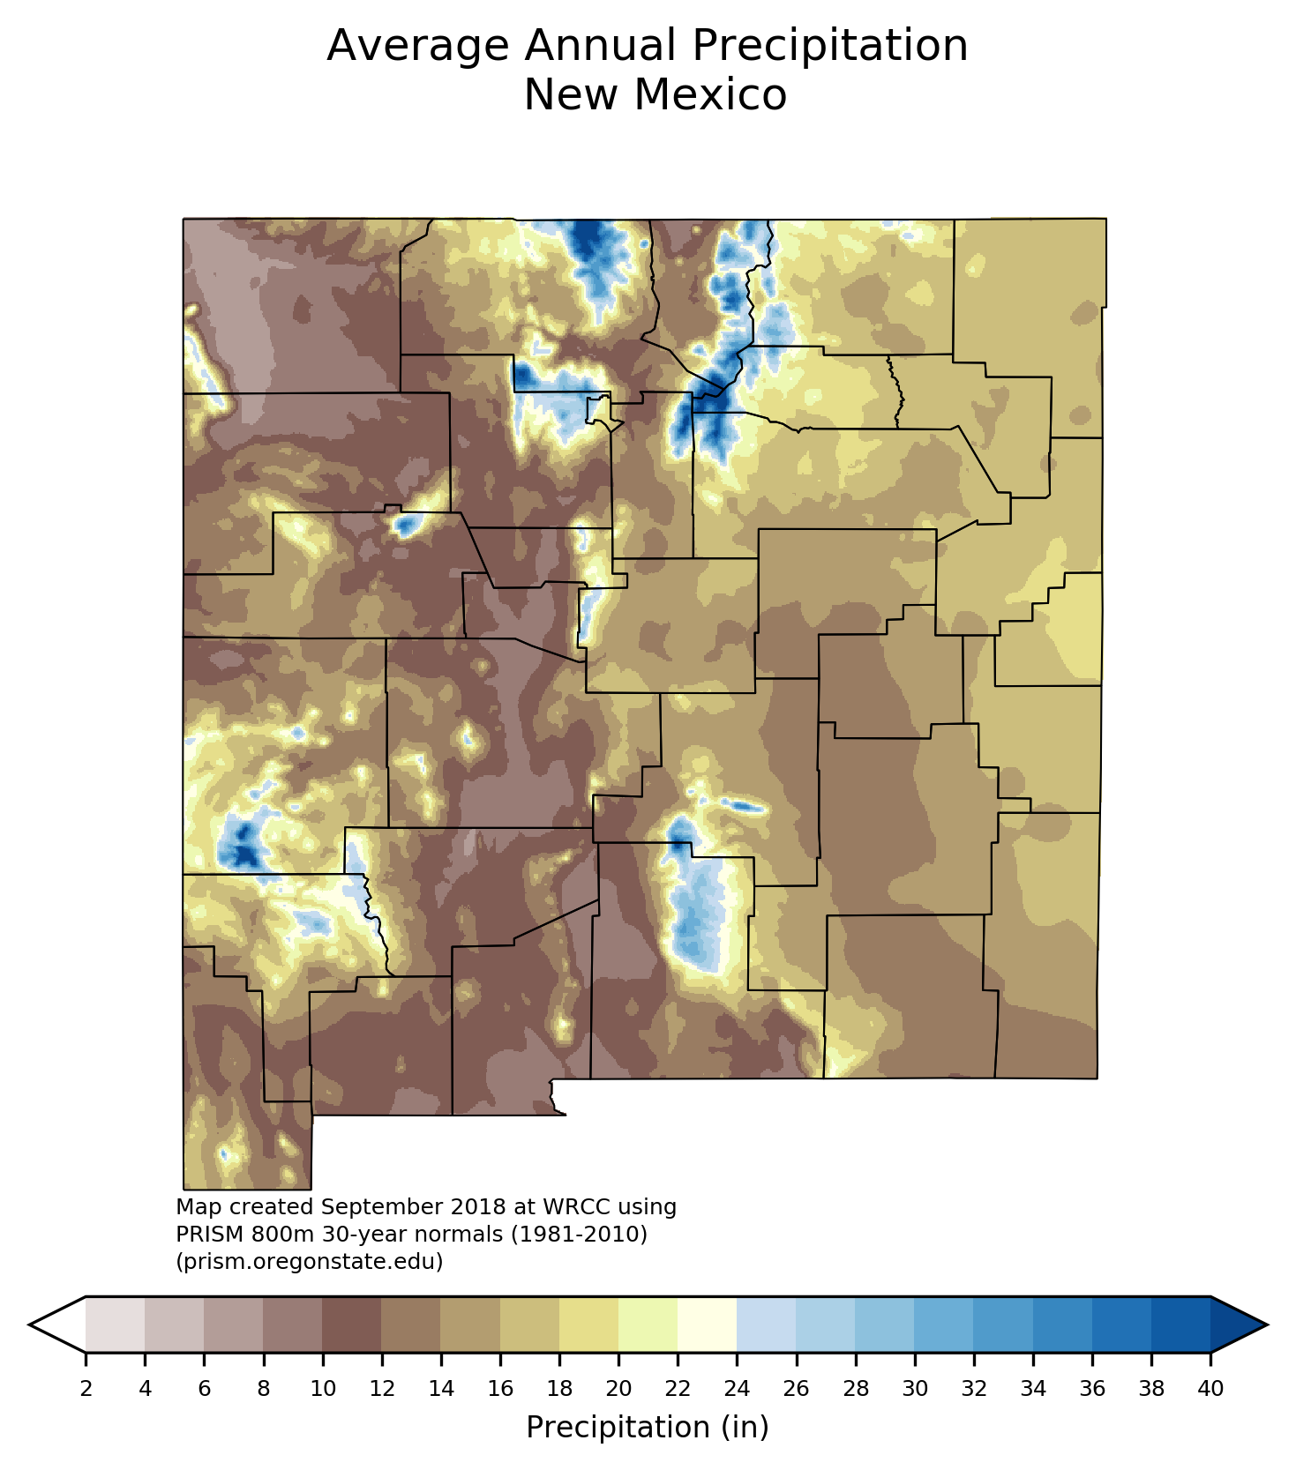
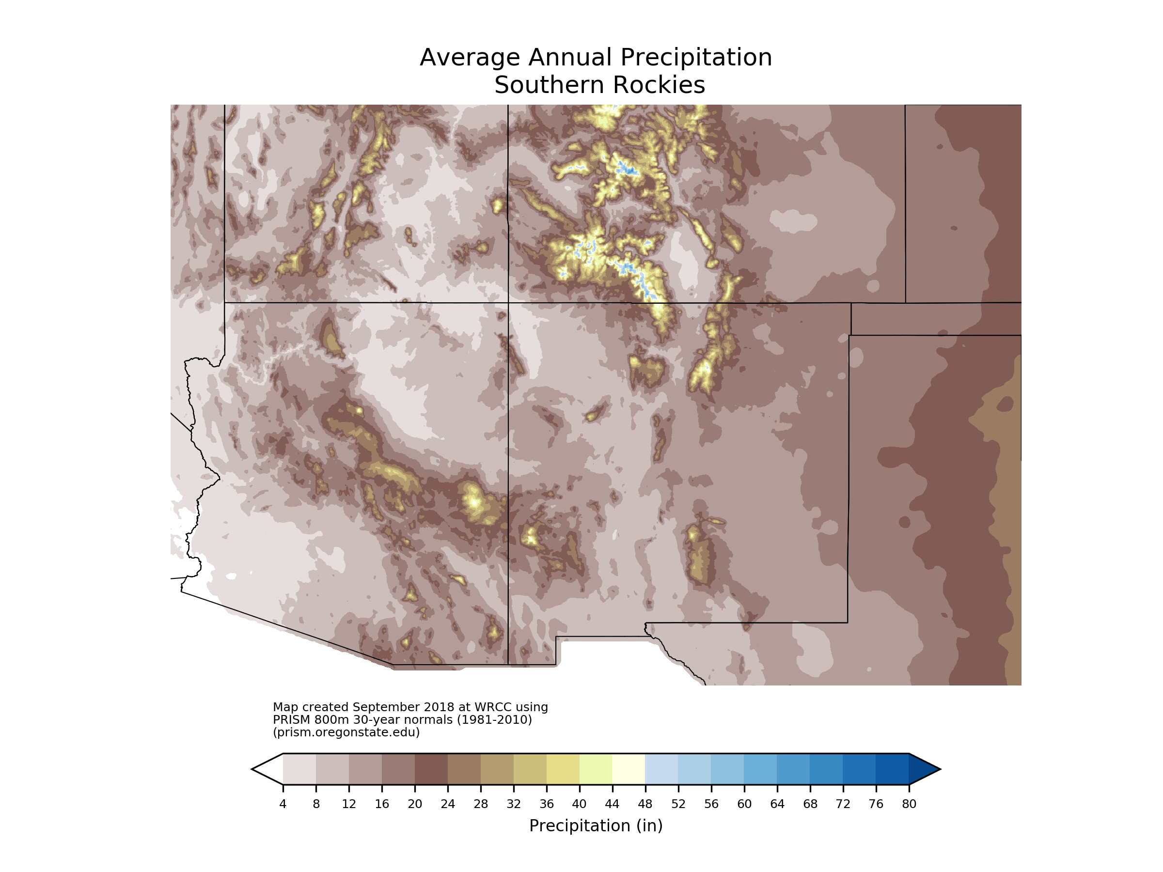
PRISM PrecipITATION MAPS https://wrcc.dri.edu/Climate/prism_precip_maps.php
800m PRISM map of 30 year normal for 1981-2010
PRISM climate data:
https://prism.oregonstate.edu/
Basically a visualization / map of what is provided on DRI pages
Monthly average precipitation by state , annual average precip by state, annual average precip by region for 1981-2010
DRI website doesn’t provide actual data, only gives climate normal based on data
Also offers 1961-1990

Slide 12
TO DO
Pdf with metadata and descriptions for recurrence intervals
Does nexrad data give data as points? How accessible is it
Does Carlsbad national park data look any different? Download in inches
How is it delivered? Discrete time intervals?
More documentation on recurrence interval rainfall data
Read into NEXRAD radar data, can it be put into a useful form? Rainfall maps?
Is there a way to get rainfall maps of individual storms, or interval rainfall values?
NEXRAD is a map, possibly get daily or hourly rainfall maps of area?
Independent gis project looking at relief and structure
Data packet exploring rainfall and river data

